Slide 1
CYBER PSYCHOLOGY
TOPIC:INTRODUCTION TO CYBER PSYCHOLOGY

Slide 2
CONTENTS
Introduction
Definition of Cyber Psychology
Practical uses of cyber psychology
Cybernetics
origins of AI (Artificial intelligence )in cybernetics
Cyberspace as Psychological space
Psychology in Cyberspace
Emerging field of research in Cyber Psychology
Conclusion
References

Slide 3
INTRODUCTION
Cyber psychology is an emerging field of study focusing on information communication technology (ICT)and its impact of human behavior at the individual and societal level.
- DR-ANDREW J.CAMPBELL
Three are 3 societal areas
Education ,Employment, Health.
There are different factors that significantly affect the development in cyberspace.
WEB 2.O including blogging, podcasting, Wikipedia etc....

Slide 4
DEFINITION OF CYBER PSYCHOLOGY
"Cyber Psychology is an emerging field of study focusing on information communication technology (ICT)and it's impact on human behavior at the individual and societal level. "
-DR ANDREW J.CAMPBELL

Slide 5
PRACTICAL USES OF CYBER PSYCHOLOGY
It's influenced the majority of basic human behavioral traits within society.
It has Done by making technology to solve the problems easily.
3 societal areas of impact:
Eg: Education, Employment, Health

Slide 6
CYBERNETICS
.The science of communications and automatic control systems in both machines and living things.
LIMITS OF KNOWING
Science of observed system
Subjectivity
Transition from 'first- order cybernetics ' to second-order cybernetics.

Slide 7
ORIGIN OF ARTIFICIAL INTELLIGENCE
Ironically but logically.
Artificial intelligence and cybernetics mainly search for the machine intelligence.
Cybernetics started in the advance of AI
AI is dominated between 1960 and 1985.
The difficulties in AI lead to search the solutions that enlarged the field of cybernetics.

Slide 8
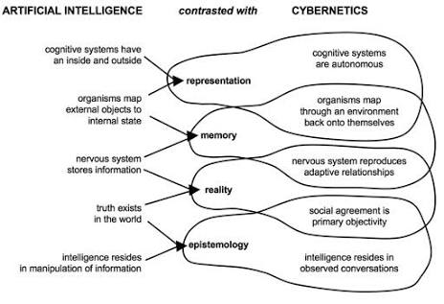
Orgins of AI (Artificial intelligence ) in cybernetics:

Slide 9
Cybernetics Today
In 20th century
Rediscovering the influence of cybernetics on the tradition.
Needs for rigorous models of goals.
Interaction and system limitations for the successful development of complex products and services.

Slide 10
CYBERSPACE AS PSYCHOLOGICAL SPACE
On the deep Psychological level, people often experience their computers and cyberspace as an extension of their minds and personalities- a "space" that reflects their tastes ,attitudes, and interest.
In psychoanalytic terms , cyberspace may become a type of "transitional space "that is an extension of the individual's intrapsychic world.
It may be experienced as an intermediate zone between self and other that is part self and part other.

Slide 11
The internet also includes the opportunity to interact with other people, a collective shaping of meaning and purpose elevates cyberspace into social space that psychologically transcends traditional media.

Slide 12
PSYCHOLOGY IN CYBERSPACE
This topic that evolved became as diverse as the discipline of psychology.
Researchers from all branches of psychology became interested in cyberspace, including cognitive, social, educational, organizational, personality, clinical, and experimental psychologist.
The boundaries of" privacy "are more complex.
Geographical boundaries are transcended
"cyberspace "or" internet" is far from being s monolithic entity. Nor static.
it is a multiplicity of environments all of which are changing field.
Psychology need to be equally swift and flexible in its methods of research and theoretical framework

Slide 13
CYBER PSYCHOLOGY- AN EMERGING FIELD OF RESEARCH
There are few factors significantly affect the development of behavior in cyberspace , but rapidly developing, some times revolutionary technology- that are impossible to predict.
WEB 2.0 including blogging, podcasting, Wikipedia etc........is the main functions of internet.
Technological innovation which influences what people are exposed to, has made a significant change in the use of the internet.
Cyber Psychology is highly dynamic.

Slide 14
CONCLUSION
In this seminar we detail learned about Cyber Psychology and its important in society and also its development.
We also learned cybernetics, its origins of AI in cybernetics and cybernetics today.
And also we learned cyberspace as psychological space ,psychology in cyberspace and Cyber Psychology -an emerging field of Research.

Slide 15
REFERENCES
Ravindra Thakur.(2011).Cyber psychology.
Global vision publishing House. New Delhi.
Suryanarayana,N.V.S.,Himabindu,G.and
Neelima, V.(2011).Cyber psychology.
http://www-usr.rider.edu/suler/psycyber/psycyber.html.

